Slide 1
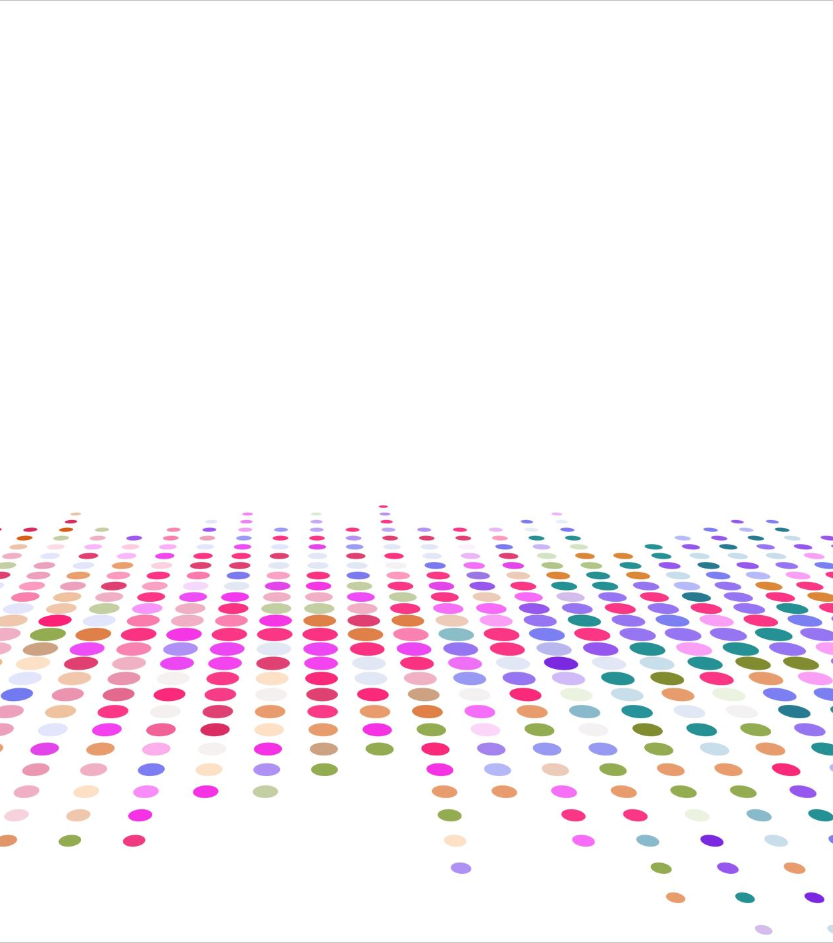
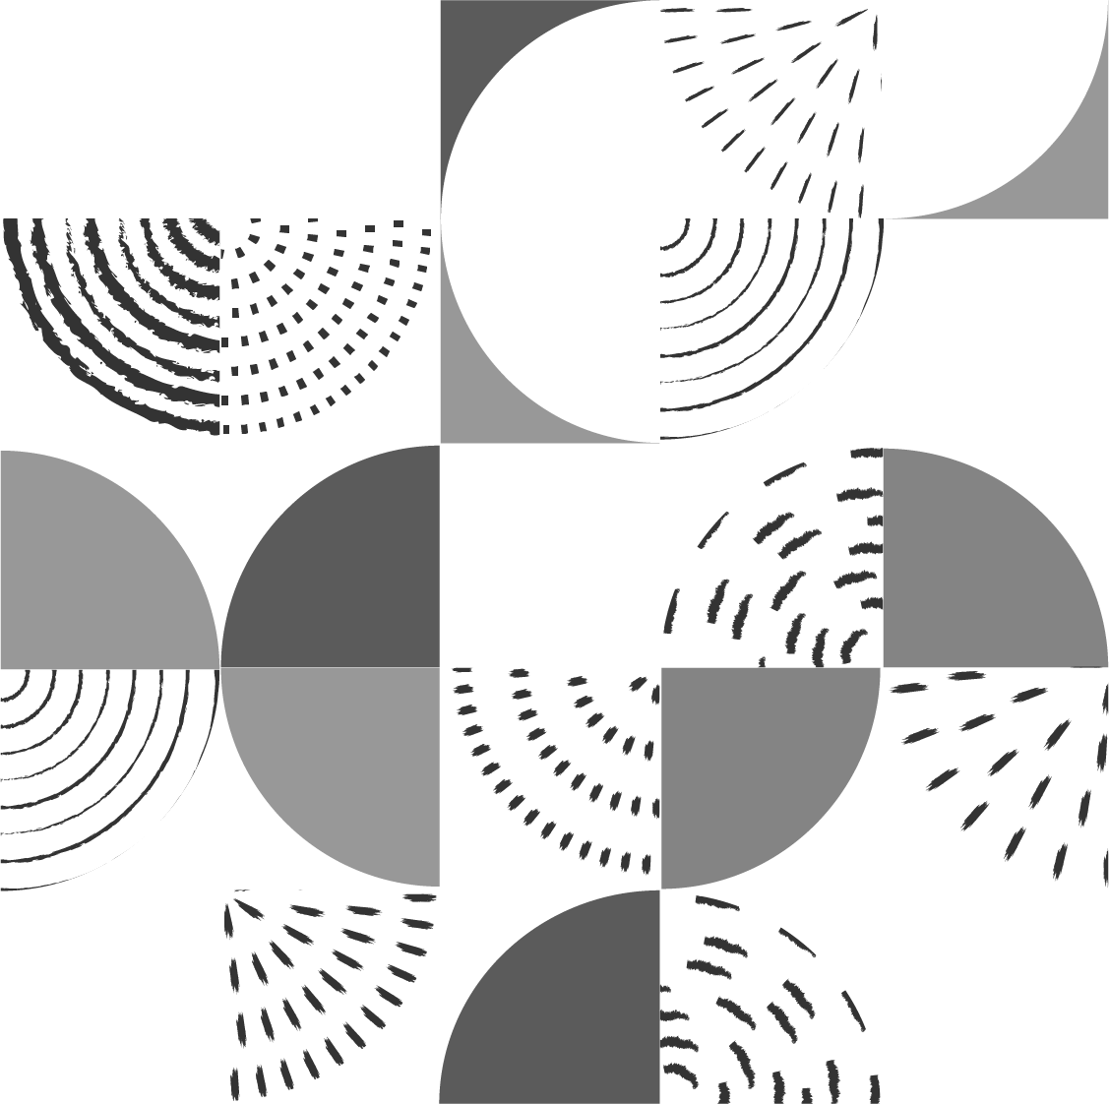
Computational Fluid Dynamics II H-Grid and C-Grid Grid Generation
Muhammad Nauval Hamzah – 23620024
Mohammad Zaini Ma’ruf - 23620015

Slide 2
START
A
B
Nodal Configuration
jMax, nairfoil, ngap, nflap, nAirfoilWake, nOutflow
Initialize Boundary Coordinates
Boundary Configuration
chord
thickness
Boundary Normalization
nwake = nAirfoilWake + nOutflow - 1
imax = 2*nAirfoil + 2*nWake + 2*nflap + 2*nwake - 7
gap = 0.1*chord
flap = 0.2*chord
rOutflow = 10*chord
rFarfield = 5*chord
wakeChord = 0.2*chord
Boundary-Blended Control Function
Initialize Point Coordinates
A
B

Slide 3
C
D
Trans-finite Interpolation
Mesh Quality
meshArea
meshSkewness
Laplace Smoothing
Mesh Quality
meshArea
meshSkewness
END
Error < 0.0001
No
C
Yes
D

Slide 4
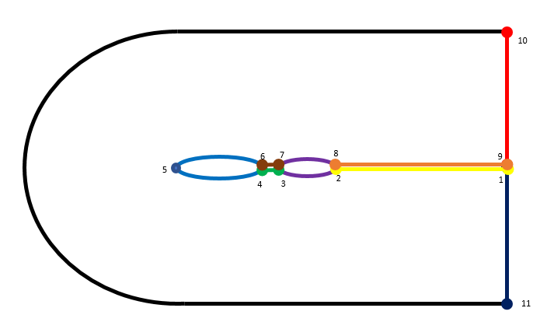
C-Grid Physical Domain
11
rOutflow
rFarfield
gap
thickness
chord
flap
12
13

Slide 5
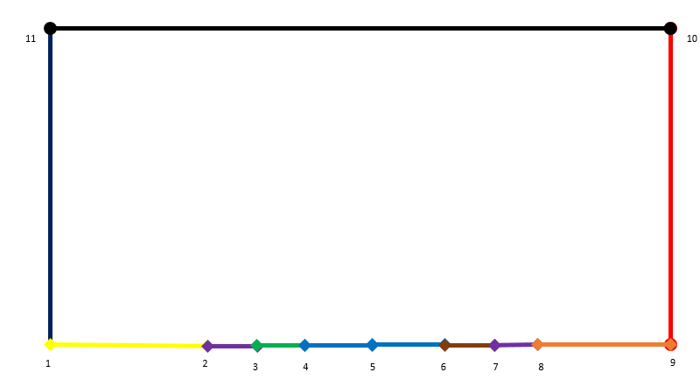
C-Grid Computational Domain
iMax
jMax
nFlap
nAirfoil
nGap
nWake

Slide 6
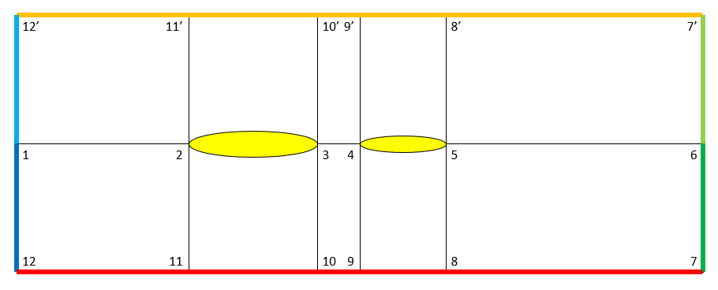
H-Grid Physical Domain
rOutflow
rFarfield
gap
thickness
chord
flap

Slide 7
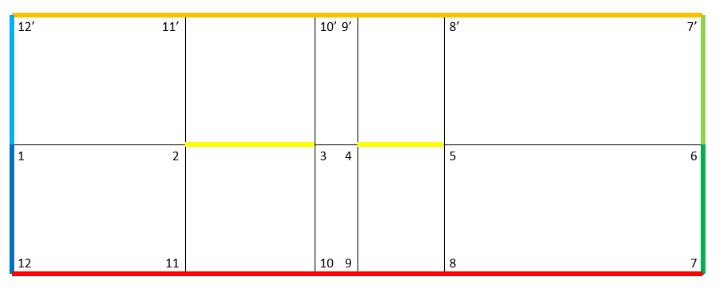
H-Grid Computational Domain
iMax
nInlet
nAirfoil
nGap
nFlap
nWake
jMax

Slide 8
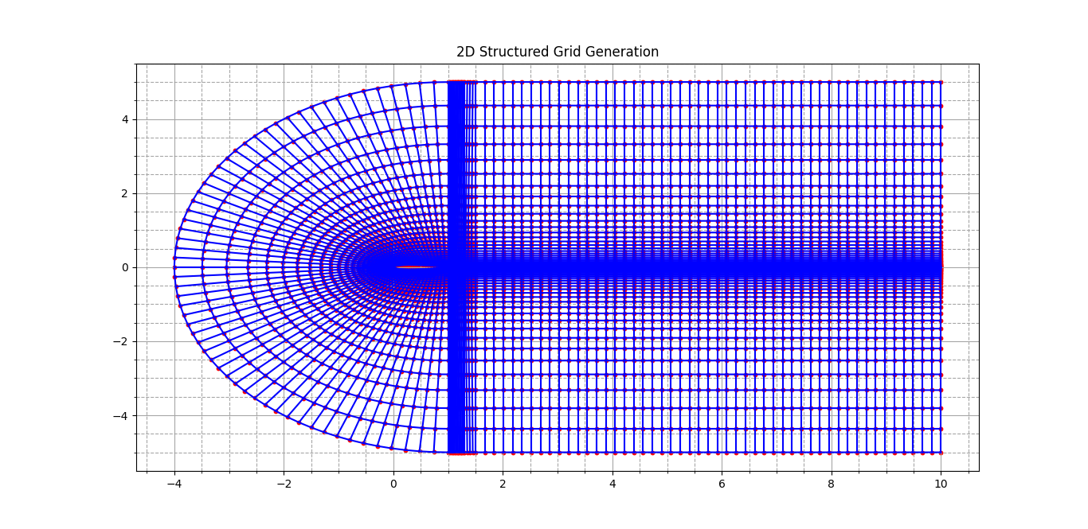

Slide 9
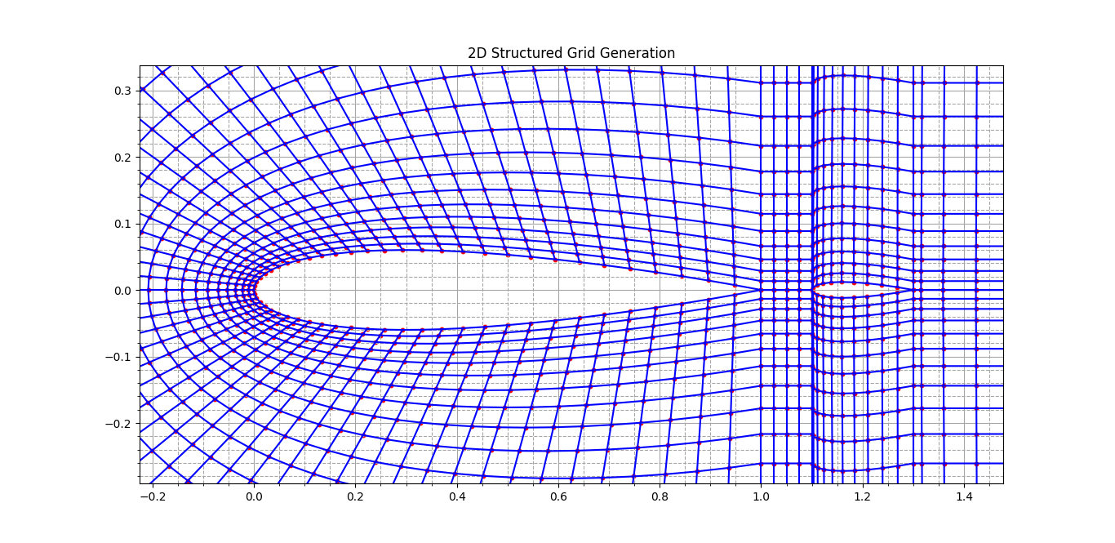

Slide 10
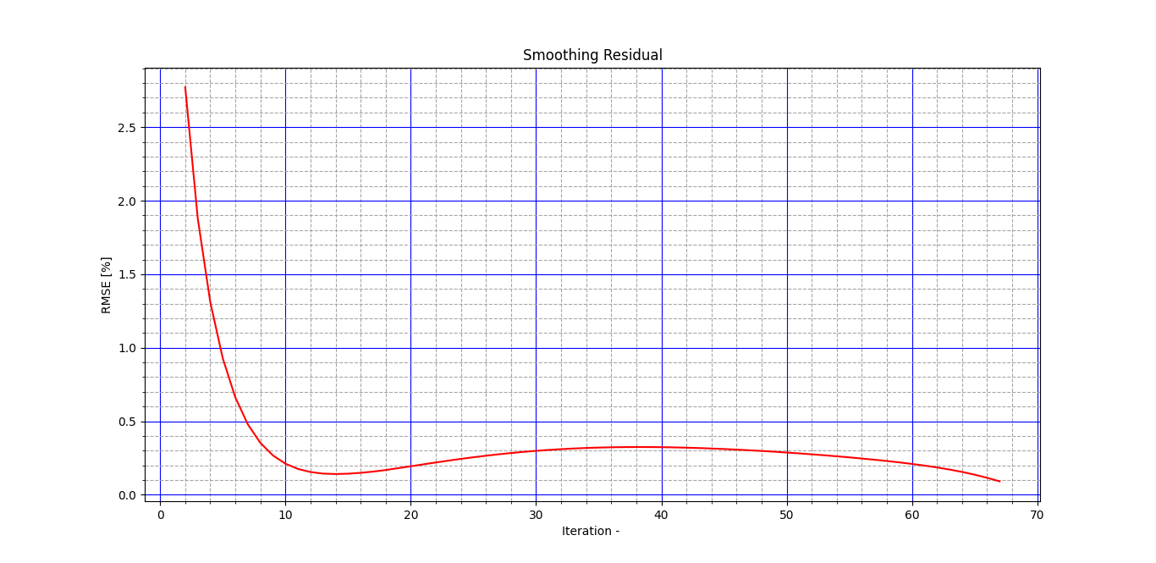

Slide 11
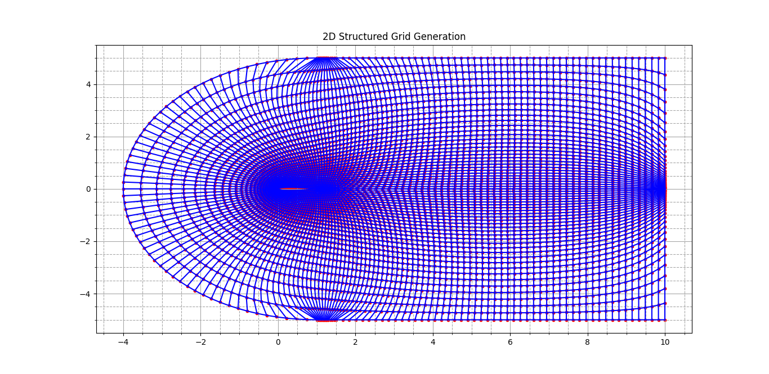

Slide 12
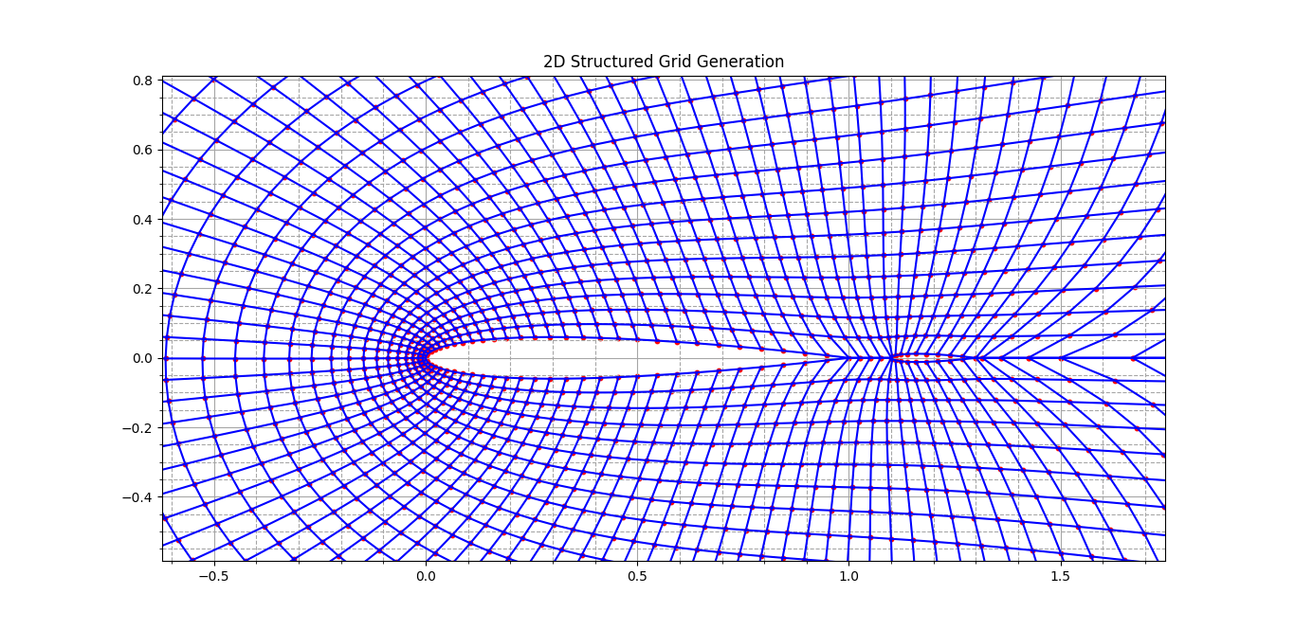

Slide 13
